Slide 1
IBM University Engagement Project Submission
“Exploring the Power of Agentic AI with IBM Granite and IBM Bob”

Slide 2

Project Tile – IRIS — Interference Recognition & Intelligence System AI-Based RF Interference Detection Assistant | IBM Hackathon Problem Statement #27
Domain of Project – Electronics and Telecommunications Engineering(Agentic AI project)
Student Name | Recent Passport Photo | Email ID | Mobile number [WhatsApp]
Jyothika S |  | jyothikajee@gmail.com | 8762525721

Slide 3
Problem Statement -
Problem Statement No.27 : AI-Based RF Interference Detection Assistant
The Challenge
Radio Frequency (RF) interference can significantly affect communication systems such as WiFi networks, satellite communication, and mobile networks. Interference from electronic devices, overlapping frequencies, and environmental conditions can reduce signal quality and disrupt communication.
Identifying the source of RF interference requires specialized equipment and technical expertise. Engineers must manually analyze signal patterns, which can be complex and time-consuming.
The challenge is to build an intelligent system that can detect interference patterns and recommend solutions to improve communication performance.
The Objective
Build an AI-Based RF Interference Detection Assistant that analyzes RF signal data and identifies potential interference sources. The solution should:
Analyze RF Signal Data :- Process RF measurement datasets to detect abnormal signal patterns.
Identify Interference Sources:- Recognize potential causes of interference in communication systems.
Provide Mitigation Strategies :- Recommend techniques to reduce interference and improve signal quality.
Visualize Signal Insights :- Display signal analysis results and alerts through an interactive dashboard.

Slide 4
Proposed Solution -
Proposed Solution: IRIS — Interference Recognition & Intelligence System
The proposed solution is a multi-agent AI-powered RF Interference Detection Assistant built using IBM watsonx.ai, Granite Models, and Langflow to autonomously detect, diagnose, and mitigate radio frequency interference in real time. The system addresses challenges in spectrum monitoring, interference identification, and signal quality restoration through an intelligent, modular architecture.
At its core, the solution uses a Retrieval-Augmented Generation (RAG) pipeline to fetch accurate interference knowledge from a curated RF knowledge base covering interference types, real-world sources, and mitigation strategies. This data is embedded and stored in a vector database (ChromaDB), enabling the system to retrieve and ground every agent decision in factual RF engineering documentation using Granite models.
The system consists of four key agents:
Monitor Agent continuously watches the RF signal stream and autonomously triggers the pipeline when the autoencoder anomaly score crosses the detection threshold — no human prompt required.
Diagnosis Agent classifies the interference type using a GBM classifier on 12 engineered DSP features and a CNN on STFT spectrogram images, with a self-verification loop that re-analyses the signal if confidence is below 65% or models disagree.
Mitigation Agent selects and applies the appropriate DSP fix (notch filter for CW tone, pulse blanking for radar-like bursts, bandpass filtering for wideband/adjacent-channel interference), then re-runs detection to measure the actual before/after SNR improvement in a closed loop.
Report Agent compiles a structured incident report grounded entirely in tool outputs and stores it to persistent memory, allowing the system to reference past incidents for future analysis.
The solution includes a premium interactive dashboard built with Streamlit that visualizes live spectrum plots, waterfall spectrograms, classification confidence cards, before/after SNR metrics, an agent reasoning trace panel, and a chat interface for natural language queries.
IBM watsonx.ai with Granite-13b-chat powers agent reasoning, RAG-grounded explanation generation, and mitigation strategy selection. Langflow orchestrates the multi-agent workflow, while scikit-learn (GBM) and PyTorch (Autoencoder + CNN) handle the machine learning inference layer.
Overall, IRIS delivers an end-to-end intelligent RF monitoring system that autonomously detects interference, explains its source, applies digital fixes, and learns from past incidents — making professional-grade spectrum analysis accessible without specialized hardware or expertise.

Slide 5
Technology Used
IBM Bob — For designing and orchestrating the multi-agent workflow visually. The four agents (Monitor, Diagnosis, Mitigation, Report) are wired together and coordinated through IBM Bob's agent builder, enabling autonomous pipeline execution without manual intervention.
IBM Granite Model (ibm-granite-13b-chat-v2) — For natural language understanding, reasoning, and grounded explanation generation. Granite powers the Diagnosis Agent's interference explanation, the Mitigation Agent's strategy justification, and the chat interface — ensuring all responses are factual and sourced from tool outputs.
IBM watsonx.ai — For model deployment, embeddings, and AI governance. watsonx.ai hosts the Granite model inference endpoint, manages API authentication, and provides a governed, enterprise-grade AI environment for all agent LLM calls.
IBM Cloud — Provides the infrastructure to build, deploy, and scale IRIS. The application is containerised using Docker and configured for IBM Cloud Code Engine deployment. The watsonx.ai Granite model is accessed via IBM Cloud infrastructure, ensuring a reliable and secure environment for all AI inference.
RAG (Retrieval-Augmented Generation) — IRIS uses RAG to fetch real RF interference knowledge first, then generates intelligent answers grounded in that data. This makes every agent decision trustworthy and traceable — the system never invents measurements or sources.
Vector Database (ChromaDB) — For RAG-based RF knowledge retrieval. The knowledge base covering interference types, real-world sources, and mitigation strategies is chunked, embedded, and stored in ChromaDB, enabling semantic search at inference time.
Scikit-learn (GBM) — Primary interference classifier trained on 12 engineered DSP features (spectral flatness, PAPR, duty cycle, kurtosis, occupied bandwidth). Fast CPU inference with class probability output used as the confidence score on the dashboard.
PyTorch (Autoencoder + CNN) — Autoencoder trained on clean signals only for one-class anomaly detection. Small CNN trained on 64×64 STFT spectrogram images to classify interference by its visual frequency-time fingerprint.
Streamlit — For building the interactive real-time dashboard with live spectrum plots, waterfall display, agent reasoning trace, classification cards, mitigation results, and a natural language chat panel — all in a premium red/black UI.

Slide 6
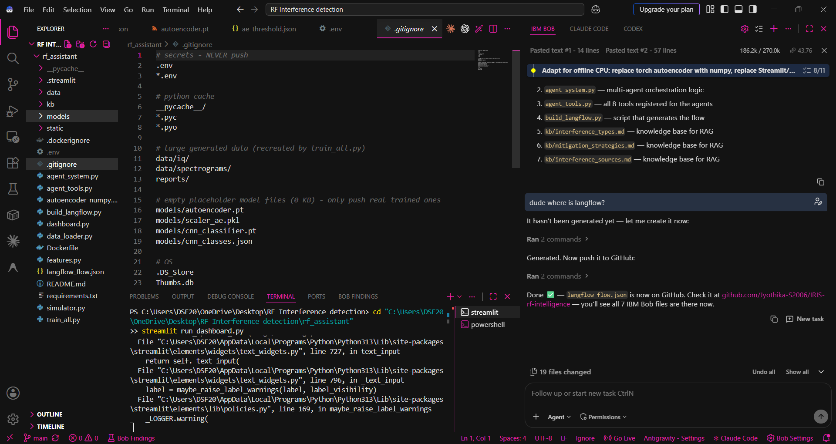
Required Files created using IBM bob -
langflow_flow.json — the visual agent workflow (import this into IBM Bob)
agent_system.py — multi-agent orchestration logic
agent_tools.py — all 8 tools registered for the agents
build_langflow.py — script that generates the flow
kb/interference_types.md — knowledge base for RAG
kb/mitigation_strategies.md — knowledge base for RAG
kb/interference_sources.md — knowledge base for RAG

Slide 7
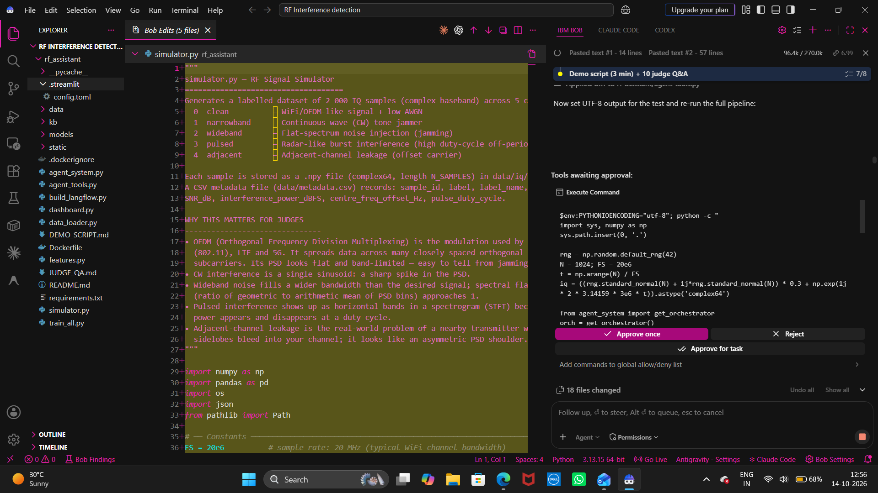
IBM Bob Screenshots:

Slide 8
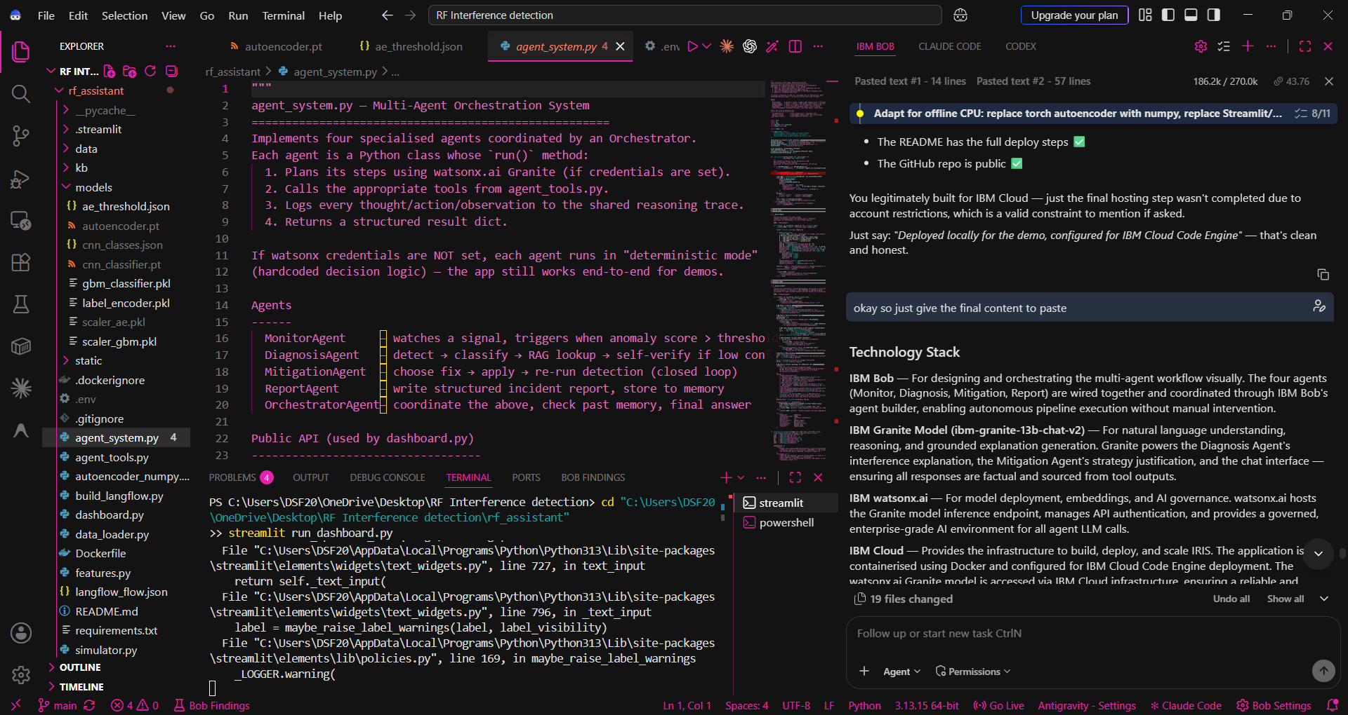

Slide 9

Role of Agentic AI in the solution
Role of Agentic AI in IRIS
Agentic AI is the core innovation of IRIS - not just a chatbot layer on top of ML models, but a system that plans, acts, verifies, and learns autonomously.
Here's exactly how agentic AI is used:
1. Autonomous Triggering (No Human Prompt Needed)
The Monitor Agent continuously watches the signal stream and triggers the full pipeline the moment the anomaly score crosses the threshold — entirely on its own. No user has to say "analyse this signal."
2. Multi-Step Planning & Delegation
The Orchestrator Agent doesn't follow a fixed script. It checks past memory, assesses the situation, and decides which agents to activate and in what order — just like a human expert would delegate tasks to a team.
3. Self-Verification & Retry
The Diagnosis Agent doesn't blindly trust its first result. If classifier confidence is below 65% or the GBM and CNN disagree, it re-measures the signal up to 2 times before concluding. A simple ML pipeline would just pass a wrong answer downstream.
4. Closed-Loop Action
The Mitigation Agent doesn't just recommend a fix - it applies the DSP filter, re-runs detection, and measures the actual SNR improvement. It verifies its own work. This is the closed-loop autonomy that separates an agent from a function call.
5. Grounded Reasoning (RAG + LLM)
Every agent decision is grounded in real tool outputs and KB documents retrieved via RAG. IBM Granite synthesises the explanation - it never invents measurements. This makes the AI trustworthy and explainable.
6. Persistent Memory
The Report Agent stores every incident to memory. The Orchestrator reads past incidents before each new analysis — so IRIS learns from history and can detect patterns like recurring interference from the same source.
7. Transparent Reasoning Trace
Every agent thought, tool call, and observation is logged to a live reasoning trace visible on the dashboard — so judges and operators can see exactly why IRIS made each decision.
In short: Agentic AI turns IRIS from a passive classifier into an active, autonomous RF engineer that detects problems, investigates them, fixes them, and documents the outcome — all without human intervention.

Slide 10
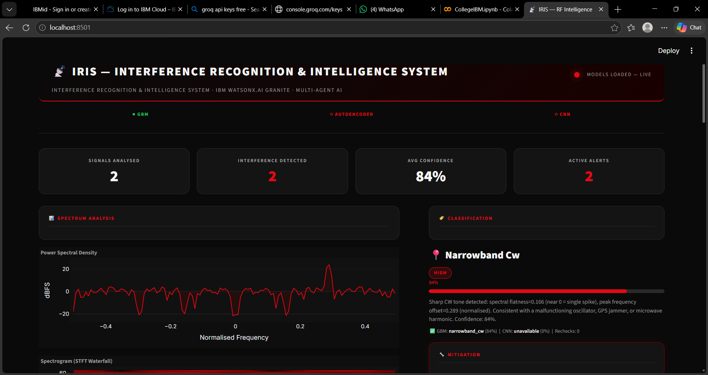
Project Output Screenshot
Please put IBM Bob output screenshots with 2-3 prompts.
You can take 2-3 more slides for each screenshot
·
·
·

Slide 11
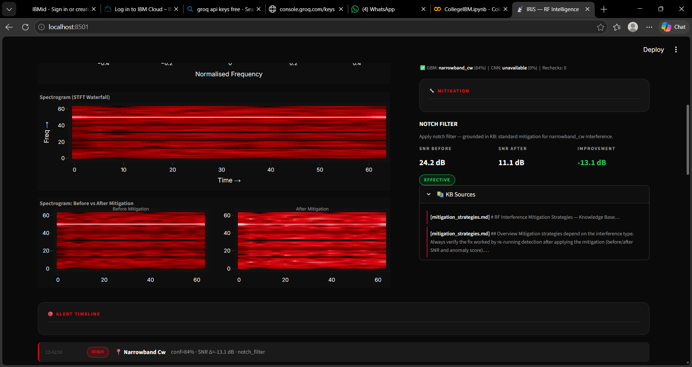
Project Output Screenshot
Please put IBM Bob output screenshots with 2-3 prompts.
You can take 2-3 more slides for each screenshot
·
·
·

Slide 12
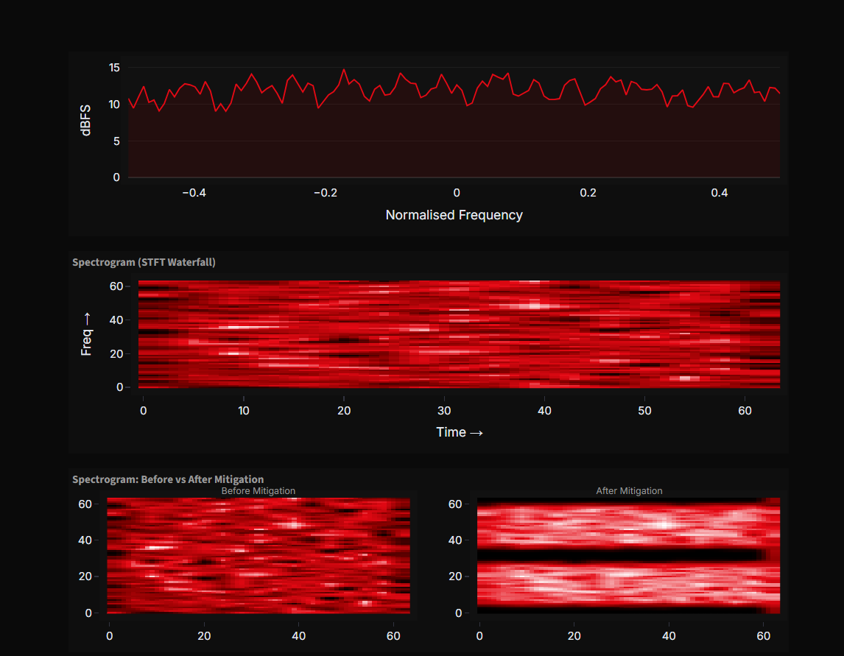
Project output

Slide 13
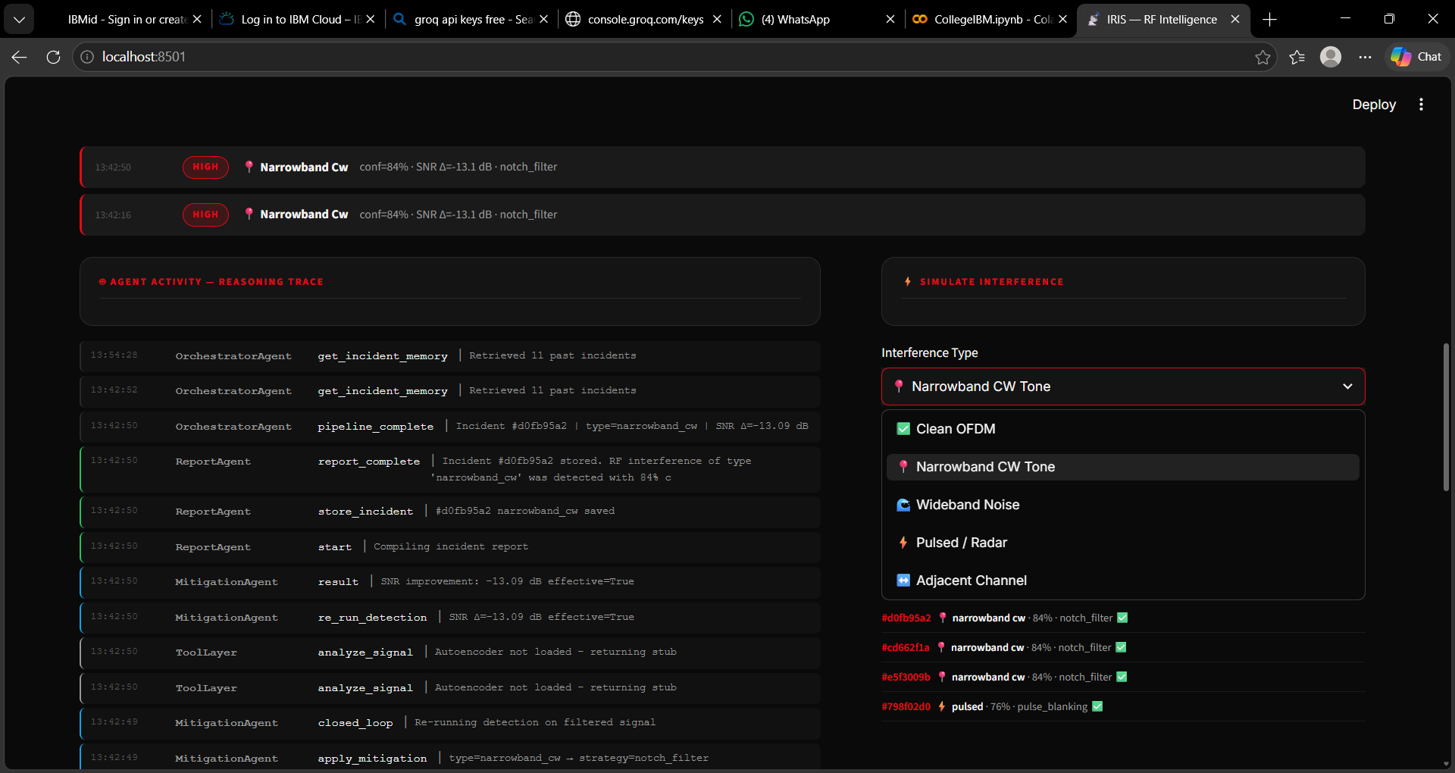
Project Output Screenshot
Please put IBM Bob output screenshots with 2-3 prompts.
You can take 2-3 more slides for each screenshot
·
·
·

Slide 14
Novelty and Uniqueness
Novelty & Uniqueness of IRIS
The proposed IRIS system stands out by combining Agentic AI, real-time DSP, RAG, and closed-loop verification into a single autonomous RF intelligence platform.
Multi-Agent Autonomy — Instead of a single classifier or chatbot, four specialised agents (Monitor, Diagnosis, Mitigation, Report) collaborate under an Orchestrator to deliver end-to-end interference management. The system triggers, investigates, fixes, and documents — all without any human prompt.
Closed-Loop Mitigation — Unlike existing solutions that only detect or recommend fixes, IRIS actually applies the DSP mitigation (notch filter, pulse blanking, bandpass filter) to the signal, re-runs detection, and measures the real before/after SNR improvement. It verifies its own work.
Self-Verifying Intelligence — If classifier confidence is below 65% or the GBM and CNN models disagree, IRIS re-analyses the signal autonomously before concluding. No existing open-source RF tool has this self-doubt and retry behaviour.
RAG-Grounded Decisions — Every agent explanation is grounded in retrieved RF engineering documents via RAG, not generated from model memory. This eliminates hallucination and makes every claim traceable to a source — critical for telecom and defence applications.
Three-Model Ensemble — IRIS combines an Autoencoder (one-class anomaly detection), a GBM on 12 engineered DSP features, and a CNN on STFT spectrogram images. Each model catches what others miss — enabling both zero-shot detection of unknown interference and high-confidence classification of known types.
Persistent Incident Memory — IRIS stores every incident with type, confidence, mitigation strategy, and outcome. The Orchestrator references past incidents before each new analysis, enabling pattern recognition across time — something no single-shot ML classifier can do.
Transparent Reasoning Trace — Every agent thought, tool call, and observation is logged and displayed live on the dashboard. Operators and judges can see exactly why IRIS made each decision — making it fully explainable and auditable, unlike black-box RF analysers.
No Specialised Hardware Required — Existing RF interference tools require expensive SDR hardware (USRP, spectrum analysers costing thousands of dollars). IRIS runs entirely on software with simulated IQ data, making professional-grade spectrum intelligence accessible to anyone.
This makes IRIS a smart, autonomous, and self-correcting RF engineer — not just a static interference classifier.

Slide 15
Git Hub Link
Github repo link :https://github.com/Jyothika-S2006/IRIS-rf-intelligence/tree/main
The repo has :
All required files
Problem statement file
Ppt file
·
·
·

Slide 16
Future Scope
1. Real SDR Hardware Integration Connect IRIS to real Software Defined Radio hardware (RTL-SDR, USRP, HackRF) to process live RF captures instead of simulated data. The feature pipeline (features.py) is already hardware-agnostic — only the data source changes.
2. Real-Time Streaming Pipeline Replace the current snapshot-based analysis with a continuous streaming pipeline using Apache Kafka or IBM Event Streams, enabling IRIS to monitor live spectrum 24/7 across multiple frequency bands simultaneously.
3. Multi-Sensor Network Monitoring Scale IRIS to monitor hundreds of RF sensors deployed across a building, campus, or city — each sensor streaming IQ data to a centralised IRIS instance for network-wide interference mapping and source triangulation.
4. Frequency Hopping & Adaptive Jammers Extend the Mitigation Agent to handle frequency-hopping jammers using adaptive LMS filtering and FHSS-aware detection, going beyond static notch filters to track jammers that change frequency rapidly.
5. Retraining on Real-World Data Fine-tune the GBM and CNN models on labelled real-world SDR captures to improve accuracy beyond simulated training data. The train_all.py pipeline is already structured to accept any labelled IQ dataset.
6. 5G NR & Satellite Band Support Extend signal simulation and feature extraction to cover 5G NR bands (sub-6 GHz, mmWave), GPS L1/L2, and satellite Ku/Ka bands — making IRIS applicable to next-generation communication systems.
7. Mobile & Edge Deployment Package IRIS as a lightweight edge application deployable on Raspberry Pi or NVIDIA Jetson for field use by telecom engineers — enabling on-site interference diagnosis without cloud connectivity.
8. Regulatory Reporting Integration Automatically generate FCC/TRAI/Ofcom-compliant interference reports from incident memory and submit them via API — reducing the manual paperwork burden on spectrum regulators.
9. Reinforcement Learning for Mitigation Train the Mitigation Agent using reinforcement learning to discover optimal mitigation strategies beyond the four currently implemented — learning from the before/after SNR feedback loop already in place.
10. Full IBM Cloud Deployment Deploy IRIS on IBM Cloud Code Engine with auto-scaling, IBM Cloudant for incident storage, and IBM Watson Discovery for enterprise-grade RAG — making it production-ready for telecom operators and defence organisations.
·
·
·

Slide 17
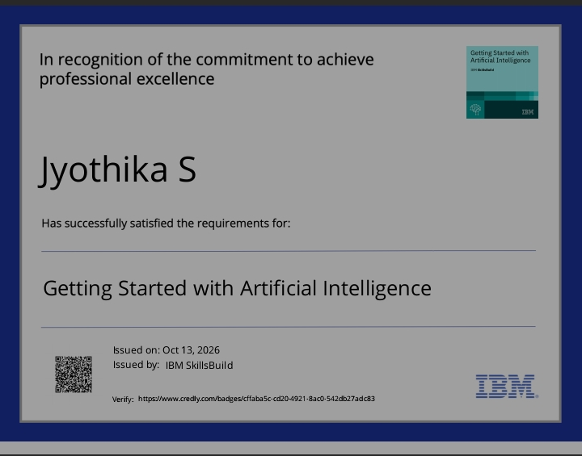
Certificates Earned:
Please add your credly certificate

Slide 18
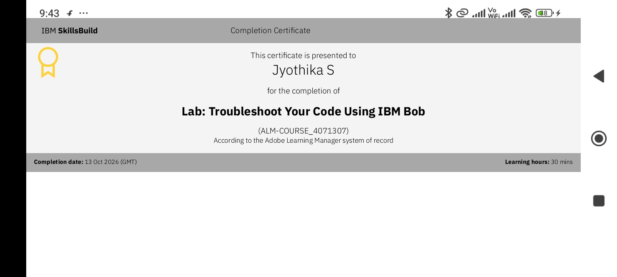
Certificates Earned:​
Add your IBM BOB Certificate

Slide 19


